Slide 2
Setting the Scene
These sessions are designed to provide you with the information and tools to help you:
Become more informed about the changes to the world of work as a result of virtual working.
Develop the skills that you will need to work virtually.
Be ready for working virtually
Ensure you focus on your wellbeing
Please take the opportunity to join in the discussion and share your thoughts. Virtual working is a new way of working to many people so let’s take some time to understand more about it and how we can be prepared!
Notes:
Session 1 – Setting the Scene (30 mins)
These sessions have been developed by Developing the Young Workforce in collaboration with educators and employers and aims to give young people the information and tools to:
Become more informed about the changes to the world of work as a result of virtual working.
Develop the skills that they will require to work virtually.
Be ready for working virtually.
Ensure they focus on their wellbeing.
Please take the opportunity to join in the discussion and share your thoughts. Virtual working is new way of working to many people so let’s take some time to understand more about it and how we can be prepared!
The first part of this session will set the scene for virtual working, covering what is virtual/remote working, practical examples of how this has impacted day-to-day tasks and thoughts for the future.

Slide 3
WHAT IS VIRTUAL WORKING?
Employees carry out the tasks required of them in their job individually, from different locations (usually a home environment), rather than altogether in a central office location.
DID VIRTUAL WORKING EXIST BEFORE COVID-19?
Some businesses allowed employees the opportunity to work from home before Covid-19.
The government guidelines remain that people should continue to work from home if they are able to do so. Covid-19 has forced businesses to put provisions in place to ensure that employees can carry out their job effectively from home.
Notes:
Firstly, what is virtual working? Does anyone know someone – a family member or friend - who is working virtually and what this means?
Virtual working is when employees carry out the tasks required of them in their job individually, from different locations (usually a home environment), rather than carrying out these tasks altogether, in a central office location.
This is resulted in a much larger focus and reliance on technology for most businesses, to enable employees to do their job effectively and stay connected with colleagues.
Did virtual working exist before Covid-19?
In March 2020, due to covid-19, the government instructed all non-essential businesses to close and employees were sent to work from home. The government guidelines remain that people should continue to work from home if they are able to and for many businesses, where it is not essential for employees to be in the office, their employees remain at home.
Some businesses supported employees in working from home pre-covid-19, however this was not the norm.
Covid-19 has forced businesses to put provisions in place to ensure that their employees can carry out their job effectively from home, for example providing laptops, phones, chairs etc.

Slide 4
The impact of virtual working
Practical examples of what virtual working means
Regular team meetings are done virtually rather than in person
Training courses and networking events are delivered virtually rather than in venues or conference centres
Opportunities to get to know colleagues have changed
Relationships with clients must be built virtually rather than in person
Employees don’t have access to the same equipment and space as they would in an office
Notes:
Since moving to virtual working, many elements of day-to-day working life have changed. For example:
Regular team meetings to discuss tasks, deadlines, workloads and allow time for questions, can no longer be carried out in person, therefore have to be done virtually.
Training courses and networking events which were usually held in office meeting rooms or conference centres are now not possible in person and again, have to be carried out virtually.
The way that teams and companies socialise and get to know each other has changed, for example in 2020 there were obviously no in person Christmas events.
Employees don’t have access to the same equipment that was available to them in the office, e.g. printer, phones, large monitors, PCs and a suitable desk and chair to work from.
In roles where employees work directly with clients or customers, it is important to build and maintain strong relationships and prior to virtual working, the majority of this was done face-to-face and may have included travelling to different cities or countries.

Slide 5
WHAT DOES THIS MEAN FOR THE FUTURE?
The future is still uncertain as restrictions continue, however many businesses have already said that they do not envisage all staff returning to the office on a full-time basis and that an element of virtual working will remain
Notes:
What does this mean for the future?
As the situation with Covid-19 remains ever changing, the future for ways of working is still uncertain.
However many businesses have already said that they do not envisage all staff returning to the office on a full-time basis and that an element of virtual working will remain.
For example, in August 2020, the BBC surveyed 50 of the biggest UK employers and found that at that time, 24 of the 50 did not have any plans in place to return employees to working in their offices - https://www.bbc.co.uk/news/business-53901310

Slide 6
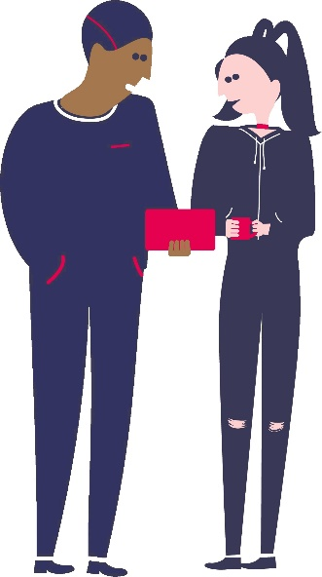
ACTIVITY
Break into small groups…
Based on what we have discussed so far, what do you think the three biggest advantages and three biggest disadvantages are about virtual working?
Notes:
Break the young people into small groups/break-out rooms.
Give the young people ten minutes in their groups to discuss the below questions and be ready to present back to the group:
What do you think the three biggest advantages and disadvantages are about working virtually?
Examples of advantages (to suggest if not raised by a group):
Less commuting means cost and time savings for employees and is more environmentally friendly.
Less overheads for companies in the long term, i.e. renting large office spaces.
Some people would say that they are more productive at home because of less distractions, e.g. chatting with colleagues.
More opportunities for employees and employers, i.e. the pool of available roles/candidates could be larger if employees and employers are not restricted by geographical location.
Examples of disadvantages (to suggest if not raised by a group):
Communicating and building relationships with colleagues can be more difficult so working from home may feel more isolating.
Lack of suitable work space, i.e. many people have to work from their bedrooms or communal living areas.
Some people would say that they are more distracted at home, e.g. family and friends being around you, household chores to complete.
Lack of exercise and fresh air due to not commuting to and from the office daily.
Technology can be problematic, e.g. although companies can provide laptops, employees often rely on their own home Wi-Fi to be able to work.

Slide 7
An opportunity to hear directly from young people about what virtual working means to them…
https://www.youtube.com/watch?v=AeKVJVLHZkM&t=12s
06:07 mins
Notes:
Play video to hear from young people currently working virtually at Phoenix Group.
Trainer Note: You can use this video or if you want to have the voice of young people coming through in your delivery you can involve young people from your organisation. Just remember, if delivering through DYW Live they would need to have a disclosure to get access to GLOW which can take some time to organise.
The video can also be linked to through You Tube separately

Slide 8
Summary
Virtual working is here to stay!
We have looked at what this means in practice
We have discussed what are the advantages and disadvantages
We have listened to young people and business telling us about their experiences of virtual working
Take some time over the next few days to think about what virtual working will mean for you. Think about how you can prepare yourself to do the best you can when it happens!...
Notes:
Let’s just recap on what we have covered
Trainer Note – You can edit the final paragraph to reflect the time between your 3 sessions.

Slide 9
Working Virtually
Notes:
Session 2 – Working Virtually (30 minutes)
We are now going to have a look at what you can do to prepare yourself to work virtually and what your employer will do to help you.
Trainer Note – you can copy the Summary slide from the last session to go over this as a starting slide, ‘before we get started let’s reflect back on what we discussed in the last session’

Slide 10
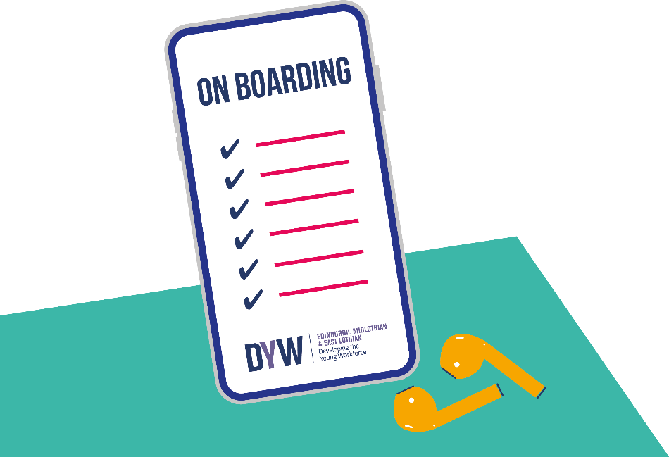
On Boarding
On Boarding is the process of getting you ready and started with a company
A company may call this Induction
It is the process of helping new members of the organisation adjust to social and performance aspects of their new jobs quickly and smoothly, and learn the attitudes, knowledge, skills, and behaviours required to work effectively
Notes:
On Boarding is the process of getting you ready and started with a company. A company may call this Induction.
It is the process of helping new members of the organisation adjust to social and performance aspects of their new jobs quickly and smoothly, and learn the attitudes, knowledge, skills, and behaviours required to work effectively.

Slide 11
Activity
Breakout into small groups
If you were starting a new job in 4 weeks’ time, what could the company do before then to help you be ready to work to the best of your ability as soon as possible after starting?
Notes:
In groups if possible: If you were starting a new job in 4 weeks’ time, what could the company do before then to help you be ready to work to the best of your ability as soon as possible after starting?
Trainer Notes: Allow the young people to feedback their thoughts through chat or using microphones, dependent on method of delivery. The next slides build on what the young people will have noted.

Slide 12
An opportunity to hear directly from an employer about onboarding and virtual working …
https://www.youtube.com/watch?v=E0zg7KJ_1p0
06:54 mins
Notes:
Let’s hear from an employer about what you can expect when you start a new job.
Trainer Note: This video gives information that is summarised and built on over the following slides. You can use the slides that follow to note, ‘as mentioned in the video’ or you can choose to not play the video and build on the details in the slides with your own experiences.
The video can also be linked to through You Tube separately or played from the webpage. www.dyw.scot/mastering-skills-for-a-new-way-of-working The page goes live w/c 25th October

Slide 13
Pre On Boarding – before you start
What you may expect from your employer:
Induction plan/kit/logins/headset etc.
Working from home assessment
What you can do – prepare and be ready for the first day
Prepare your work station (Space, background, pens/note book)
Check your wifi
Appropriate clothing
Smile on your face
Video on
Notes:
Pre – On Boarding
What you may expect from your employer:
Induction plan/kit/logins/headset etc. Your employer may provide you with equipment like laptop and a headset so you can work well at home. They should talk you through how this works and get you started.
Working from home assessment. This helps to assess where you plan to work and how, assessing aspects of health and safety to ensure risks of injury are reduced.
What you can do – prepare and be ready for the first day:
Prepare your work station (Space, background, pens/note book)
Check your wifi before you start
Appropriate clothing – what has your employer said about what to wear, if in doubt - ask.
Smile on your face – first impressions are important.
Video on – working virtually can be tricky when creating connections and building working relationships if cameras are off.

Slide 14
On Boarding
What to expect from your employer
Induction plan discussion
Policies - Health and Safety, GDPR, policies
Procedures and processes of the work place explained and documents shared
Organisation introduction – Culture, values, vision, colleagues and roles
Guidance on one to one meetings work/team meetings,
Guidance on breaks/lunch times etc
Guidance on flexible working/hours of work
Introduction to Mentor/supervisor/buddy
One to one meeting on expectations of you in the role and support available
Notes:
On Boarding
What to expect from your employer – relate back to the suggestions the young people noted from the activity
Induction plan discussion
Policies - Health and Safety, GDPR, policies
Procedures and processes of the work place explained and documents shared
Organisation introduction – Culture, values, vision, colleagues and roles
Guidance on one to one meetings work/team meetings,
Guidance on breaks/lunch times etc
Guidance on flexible working/working hours
Introduction to Mentor/supervisor/buddy
One to one meeting on expectations of you in the role and support available

Slide 15
On Boarding and Working Virtually
What your employer expects from you?
Be on time
Be prepared
Be involved
Be interested
Be an ambassador
Be respectful on social media
It isn’t possible to fully cover all the aspects of a job in, say two weeks, but it is a chance to lay the groundwork of the skills and tasks needed
Be patient and ask questions
Notes:
On Boarding and Working Virtually
What your employer expects from you?
Be on time
Be prepared
Be involved
Be interested
Be an ambassador
Be respectful on social media
Highlight - It isn’t possible to fully cover all the aspects of a job in, say two weeks, but it is a chance to lay the groundwork of the skills and tasks needed.
Emphasise the importance of being patient and asking questions.

Slide 16
Working Virtually
Prepare for each day, plan your week, take notes
Meetings and wider communications for virtual working
Professionalism, download the relevant apps required if needed – check with IT
Checking in with your mentor/buddy/supervisor
Ask for feedback, keep a note of non urgent questions
Don’t be afraid to ask questions out with check ins
You have to push yourself to do this in the virtual world of work
Have conversations, be social virtually!
Wellbeing is vital
Notes:
Working virtually
A lot of what we have discussed in relation to onboarding applies to everyday virtual working. Professionalism is important. There will be expectations from employers.
Prepare for each day, plan your week, take notes
Meetings and wider communications for virtual working
Professionalism, download the relevant apps required if needed – check with IT
Etiquette in relation virtual meetings, how to ask questions or engage. Using the hand up function
Emails – how to structure, your signature in emails and when email should be used – guidance should be offered.
Checking in with your mentor/buddy/supervisor
Ask for feedback, keep a note of non-urgent questions
Don’t be afraid to ask questions out with check ins
You might have to push yourself to do this in the virtual world of work
It is really important to connect and have conversations with colleagues, when in an actual work place this would happen at break times, in the kitchen or even socially after work. These conversations and social events can still happen when working virtually – just virtually, important to try and engage with these.
Taking breaks.
Time away from a screen, stretch the legs and check posture.
Wellbeing is vital – This will be covered in later on in the workshop.

Slide 17
Summary
We have looked at what ‘onboarding’ or ‘induction’ means
We have discussed what you can expect from your employer when you start a new role virtually
We have studied what your employer will expect from you and what you can do to prepare
We have worked through some hints and tips about how to be your best when working virtually
We have heard from some young people about their experience of starting a virtual role
Spend some time over the next few days thinking about how you can ensure you focus on your wellbeing when you are working virtually …
Notes:
Let’s revisit what we have covered during this session.

Slide 18
Wellbeing
Notes:
Session 3 – Wellbeing (30 minutes)
Trainer Note – you can copy the Summary slide from the last session to go over this as a starting slide, ‘before we get started, let’s reflect back on what we discussed in the last session’
Check in with the group as to how they are feeling – is the content so far helpful for them?
We are now going to spend some time talking about wellbeing. Looking after yourself is an important when you are working whether this is face to face with your work colleagues or virtually. When working from home, it can be easy for boundaries to blur between work and personal life. It’s natural and OK to feel anxious and uncertain in a new role as well as excited! Add to this the uncertainties about what the future will bring post covid - 19 and it important to ensure that you take care of your wellbeing so that you can be the best that you can be at work!

Slide 19
Wellbeing
What does wellbeing mean to you?
Oxford English Dictionary ‘the state of bring comfortable, healthy or happy’
Different types of wellbeing
Physical
Mental
Financial
Why is wellbeing important in the workplace?
Good for employees and for the organisation
Helps employees cope well with stress
Creates positive working environment
Increases employees’ commitment to work for the organisation
Be confident enough to share the good things and the challenges!
Notes:
Think about the question - What does wellbeing mean to you? Write your answers in the chat function/shout them out [depending on delivery media]
Oxford English Dictionary tells us wellbeing is ‘ the state of bring comfortable, health or happy’
There are several different types of wellbeing including physical, mental and financial. Talk through what is meant by these 3 types:
Physical: Not just the absence of disease but includes lifestyle behaviours to ensure physical health
Mental: Emotional, psychological and social wellbeing. Helps determine how we handle stress
Financial: How we feel about the control we have over our financial future and the relationship with money
Let’s look at - Why is wellbeing important in the workplace?
Good for employees and for the organisation. Helps employees cope well with stress and creates a positive working environment. Increases employees’ commitment to work for the organisation. Can you think of any other reasons - write in chat/shout them out (depending on delivery media).
Be confident enough to share both the good things and the challenges you are experiencing through virtual working. It will help you and others too. Many companies have introduced 'online social events' e.g. quizzes, games nights to encourage employeers to interact with each other. If they haven’t, you can put it forward as a suggestion! Providing an opportunity to communicate and connect with each other - within and outside of work - is extremely important and shouldn't be underestimated.

Slide 20
Activity
Breakout into small groups….
What do you think might be some of the active steps you could take to remain healthy whilst working virtually?
Notes:
Short Task:
Discuss in your groups – What do think might be some of the active steps you could take to remain healthy and happy whilst working virtually? Each group to feed back one or two points…
Trainer Note: The next slide offers hints and tips that you can build on and refer back to what the young people have noted from this activity.

Slide 21
Hints & Tips
Keep to your usual routine. Get a good night’s sleep!
Create a comfortable workplace
Maintain contact with your colleagues
Try to talk face to face on video where possible (think about how you are dressed and what is behind you!) to feel more connected
Take regular breaks!
Look after your physical health.
Remember to switch off
Take the time to reflect … remember what you are doing matters!
Remember you are not alone. Don’t forget your support network at work
Notes:
Here are some hints and tips to help you focus on looking after yourself:
Keep to your usual routine. Get a good night’s sleep, create a daily routine with goals to keep your mind focussed.
Create a comfortable workplace and try to only work in this space to maintain the separation between home and work.
Maintain contact with your colleagues. Decide which method of communication works best for you all.
Try to talk face to face on video where possible (think about how you are dressed and what is behind you!) to feel more connected. Talk about personal things not just work matters which you would do if you were in the office.
Take regular breaks – it’s easy to remained glued to your screen! Have a coffee, take a walk at lunchtime.
Look after your physical health. Take some time to do daily exercise either outdoors or indoors, eat healthy meals.
Remember to switch off. Don’t feel the need to check your work emails outside working hours – log out of your computer and focus on your personal activities.
Take the time to reflect. Spend a few minutes at the end of the day thinking about what you have achieved. Remember what you are doing matters!
Remember you are not alone. Many others will be feeling uncertain and perhaps isolated. Don’t forget your support network at work and don’t be afraid to reach out to your colleagues and your manager for support if you need it.

Slide 22
An opportunity to hear directly from young people about what support they have had while they have been working virtually …
https://www.youtube.com/watch?v=wzAgpJLyO94
03:08 mins
Notes:
Let’s hear again from the group of young people about what support they have received while they have been working virtually
Trainer Note: You can use this video or if you want to have the voice of young people coming through in your delivery you can involve young people from your organisation. Just remember, if delivering through DYW Live they would need to have a disclosure to get access to GLOW which can take some time to organise.
The video can also be linked to through You Tube separately

Slide 23
Available Support
At work
Your manager/mentor/buddy
Employee Assistance programmes
In some companies, a welfare desk in an office location (depending on the government guidance in place)
Outside work
Family and friends/someone you trust
The Samaritans: www.samaritans.org.uk 24 hours a day
The young.scot website has a lot of material to support mental wellbeing
Developing The Young Workforce Mindtools Microsite
https://app.mindtools.com/#/dyw-master/login.
Notes:
Available support
During the pandemic, many employees have found they really enjoy working from home but there are those who are really clear that it does not work for them. What can you do if you feel that way ? There are a wealth of support mechanisms available for you whether you feel you need some support or whether you are just interested in finding out more about what we have discussed today.
At work: Your manager/mentor/buddy is there to support you and some larger companies also have Employee Assistance Programmes with wellbeing professionals whom you can talk with in confidence. Other companies can arrange for you to have a welfare desk in an office location depending on the government guidance in place.
Outside Work: Talk to family and friends/someone you trust. The Samaritans www.samaritans.org.uk offer emotional support 24 hours a day. The Young.Scot website has a lot of material to support mental wellbeing.
Mindtools Microsite: There are a number of materials on this site which can be found in the overall session Handout provided to you.

Slide 24
Summary
We have looked at what wellbeing means and the different types of wellbeing
We have talked about why wellbeing is important in the workplace
We have spent time thinking about what you can do to remain healthy whilst working virtually
We have worked through some hints and tips around how to maintain your wellbeing
We have reviewed what support is available to you
Virtual working can be fun so take the opportunity to be as prepared as you can be to enjoy it!
Why don’t you share what you have learnt with your friends and help them be prepared too…
Notes:
Let’s recap what we have covered in this session.
It is estimated that by 2025, 70% of the global workforce will be working virtually at least 5 days a month. Having completed these sessions learning about virtual working, you should hopefully feel more confident about preparing for and starting work virtually. It can be fun! Why don’t you share what you’ve learnt with your friends and help them to be prepared too…

